Slide 1
Unit III Multiprocessor Systems
K.Vijayalakshmi / CSE Dept…

Slide 2
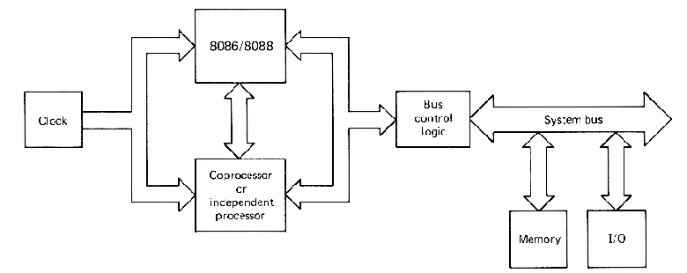
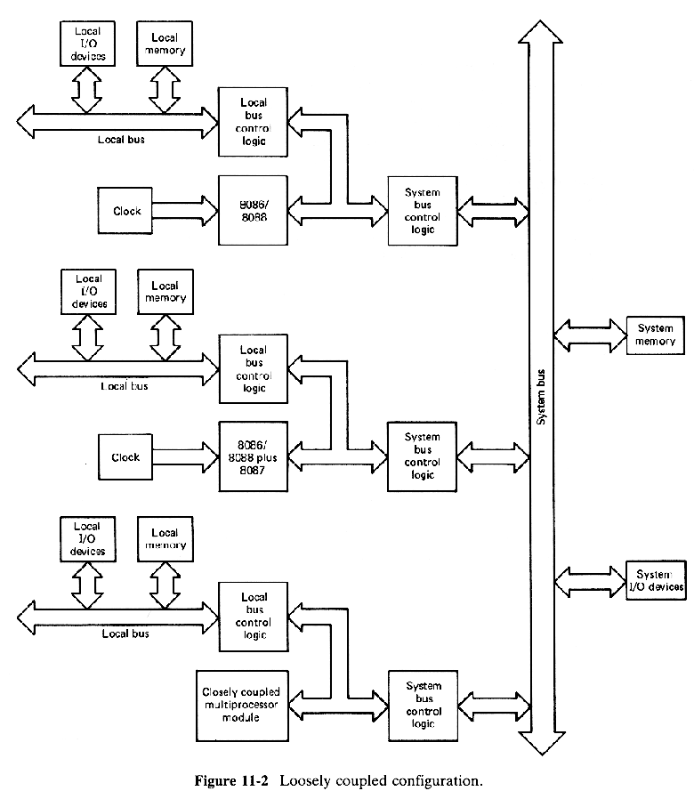
1

Slide 3
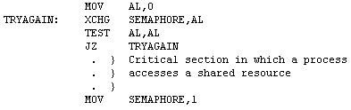
11-1 QUEUE STATUS AND THE LOCK FACILITY
Although the maximum mode and the 8288 bus controller were introduced in Chap. 8, their multiprocessing features were not considered at that point.
Because the 8086 has a 6-byte instruction queue and the 8088 has a 4-byte queue, the instruction that has just been fetched may not be executed immediately.In order to allow external logic to monitor the execution sequence, a maximum mode 8086/8088 outputs the queue status through its QS1 and QS0 pins.During each clock cycle the queue status is examined and the QS1 and QS0 bits are encoded as follows:
00 - No instruction was taken from the queue.
01 - The first byte of the current instruction was taken from the queue.
10 - The queue was flushed because of a transfer instruction.
11 - A byte other than the first byte of an instruction was taken from the queue.
Normally, semaphores are used to ensure that at any given time only one process may enter its critical section of code in which a shared resource is accessed.Let us now reconsider the semaphore implementation.
This implementation works fine for a system in which all of the processes are executed by the same processor, because the processor cannot switch from one process to another in the middle of an instruction.
Suppose that processor A is concurrently ready to update a record in memory while processor B is ready to sort the same record.Since the both processors are running independently, they might test the semaphore at the same time.
Note that the XCHG instruction requires two bus cycles, one which inputs the old semaphore and one which outputs the new semaphore.It is possible that after processor A fetches the semaphore, processor B gains control of the next bus cycle and fetches the same semaphore.
Suppose that the location SEMAPHORE contains a 1 and both processors A and B are executing
TRYAGAIN: XCHG SEMAPHORE,AL
and
  Processor A uses the first available bus cycle to get the contents of SEMAPHORE.
  Processor B uses the next bus cycle to get the contents of SEMAPHORE.
  Processor A clears SEMAPHORE during the next bus cycle, thus completing its XCHG instruction.
  Processor B clears SEMAPHORE during the next bus cycle, thus completing its XCHG instruction.
After this sequence is through, the AL registers in both processors will contain 1 and the
TEST AL,AL
instruction will cause the JZ instructions to fail.Therefore, both processors will enter their critical sections of code.
2

Slide 4

To avoid this problem, the processor that starts executing its XCHG instruction first (which in this example is processor A) must have exclusive use of the bus until the XCHG instruction is completed.On the 8086/8088 this exclusive use is guaranteed by a LOCK prefix:
which for a maximum mode CPU, activates the \LOCK output pin during the execution of the instruction that follows the prefix.
The \LOCK signal indicates to the bus control logic that no other processors may gain control of the system bus until the locked instruction is completed.To get around the problem encountered in the above example the XCHG instructions could be replaced with:
TRYAGAIN: LOCK XCHG SEMAPHORE,AL
This would ensure that each exchange will be completed in two consecutive bus cycles.
Physically, in a loosely coupled system each processing module includes a bus arbiter and the bus arbiters are connected together by special control lines in the system bus.One of these lines is a busy line which is active whenever the bus is in use.
If a \LOCK signal is sent to the arbiter controlling the bus, then that arbiter will retain control of the system by holding the busy line active until the \LOCK signal is dropped.Thus, if a processor applies a \LOCK signal throughout the execution of an entire instruction, its arbiter will not relinquish the system bus until the instruction is complete.
Another possible application of the bus lock capability is to allow fast execution of an instruction which requires several bus cycles.
For example, in a multiprocessor system a block of data can be transferred at a higher speed by using the LOCK prefix as follows:
LOCK REP MOVS DEST,SRC
During the execution of this instruction the system bus will be reserved for the sole use of the processor executing the instruction.
3

Slide 5
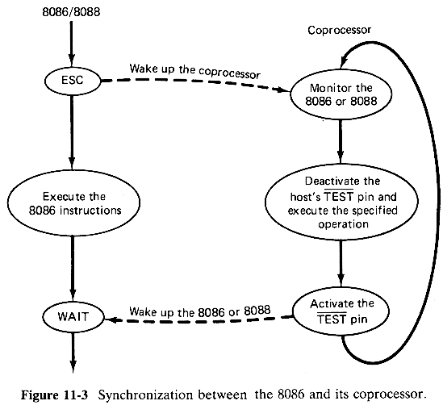
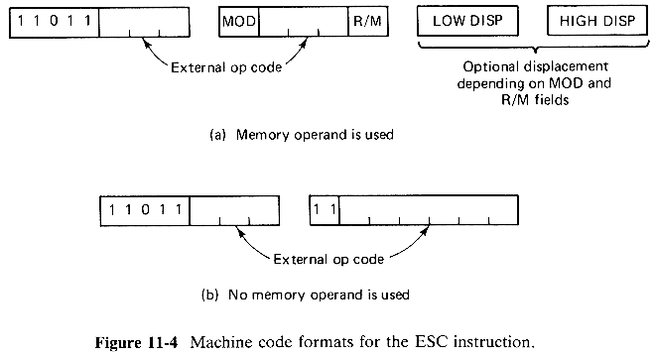
11-2 8086/8088-BASED MULTIPROCESSING SYSTEMS
Let us now consider the three fundamental multiprocessor configurations that the 8086 and 8088 are designed to support.
11-2-1 Coprocessor Configurations
4

Slide 6
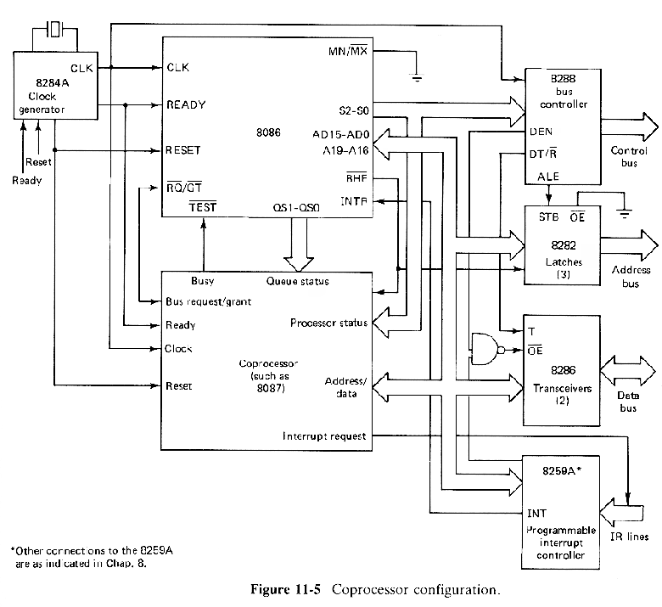
5

Slide 7
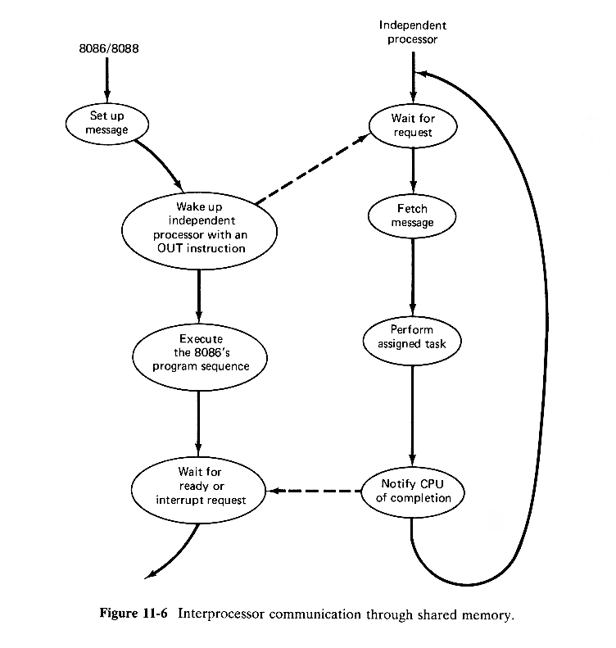
11-2-2 Closely Coupled Configurations
6

Slide 8
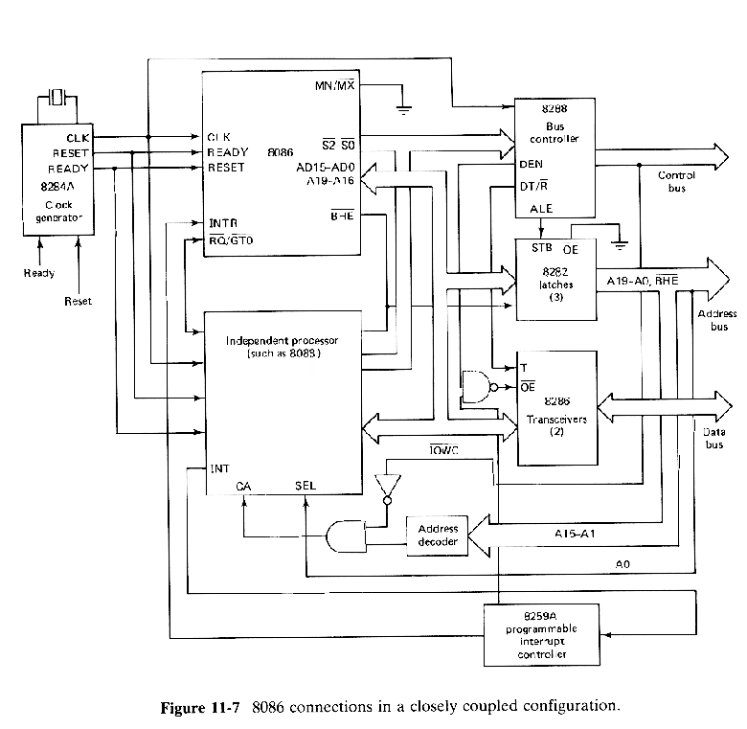
7

Slide 9
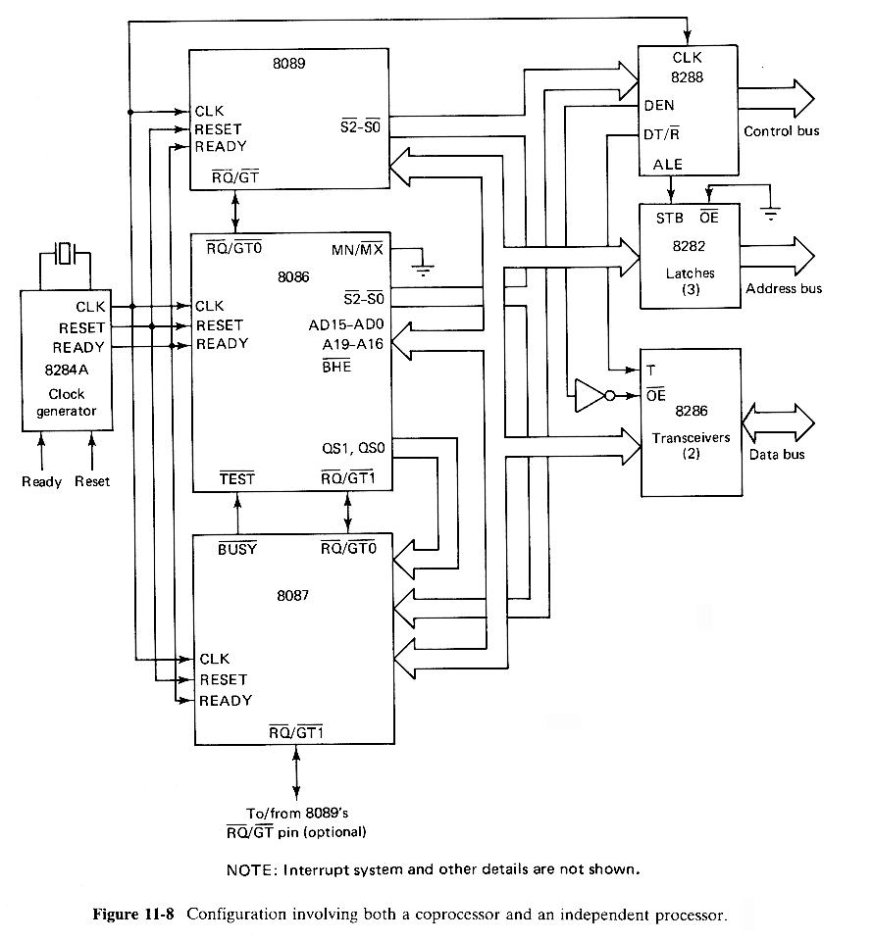
8

Slide 10
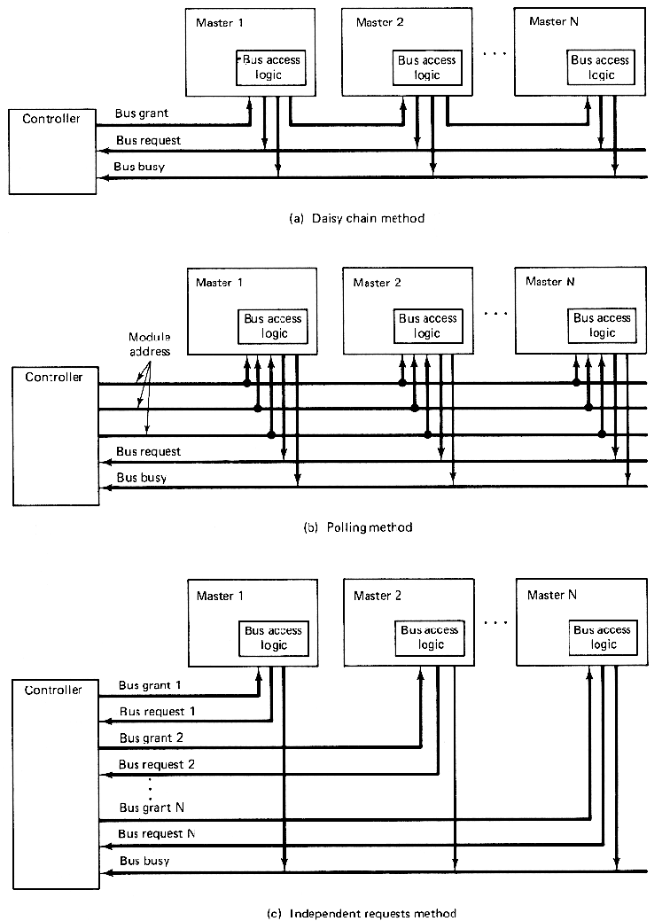
11-2-3 Loosely Coupled Configurations
A loosely coupled configuration provides the following advantages:
  High system throughput can be achieved by having more than one CPU.
  The system can be expanded in a modular form.Each bus master module is an independent unit and normally resides on a separate PC board. Therefore, a bus master module can be added or removed without affecting the other modules in the system.
  A failure in one module normally does not cause a breakdown of the entire system and the faulty module can be easily detected and replaced.
  Each bus master may have a local bus to access dedicated memory or I/O devices so that a greater degree of parallel processing can be achieved.
In a loosely coupled multiprocessor system, more than one bus master module may have access to the shared system bus.Since each master is running independently, extra bus control logic must be provided to resolve the bus arbitration problem.This extra logic is called bus access logic and it is its responsibility to make sure that only one bus master at a time has control of the bus.Simultaneous bus requests are resolved on a priority basis. There are three schemes for establishing priority:
  Daisy chaining.
  Polling.
  Independent requesting.
9

Slide 11
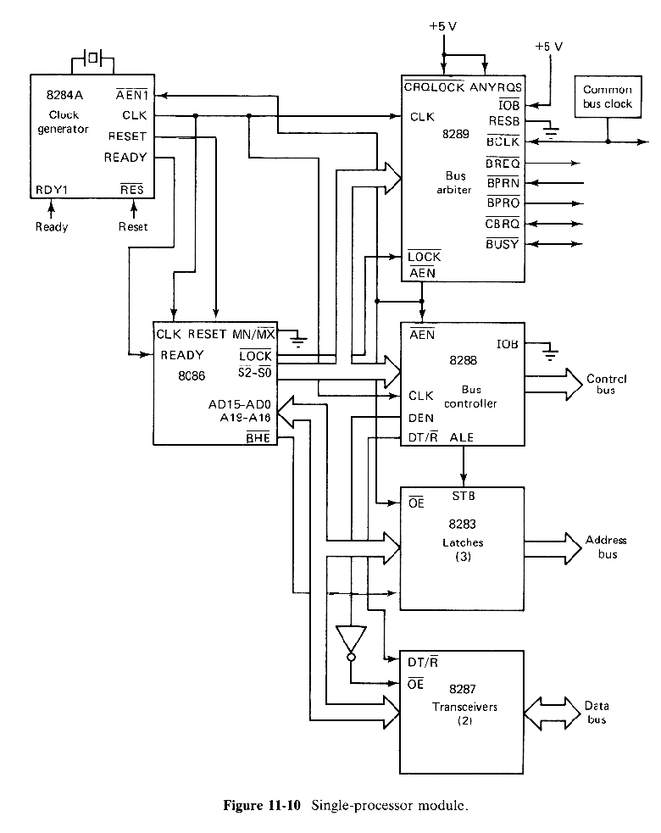
10

Slide 12
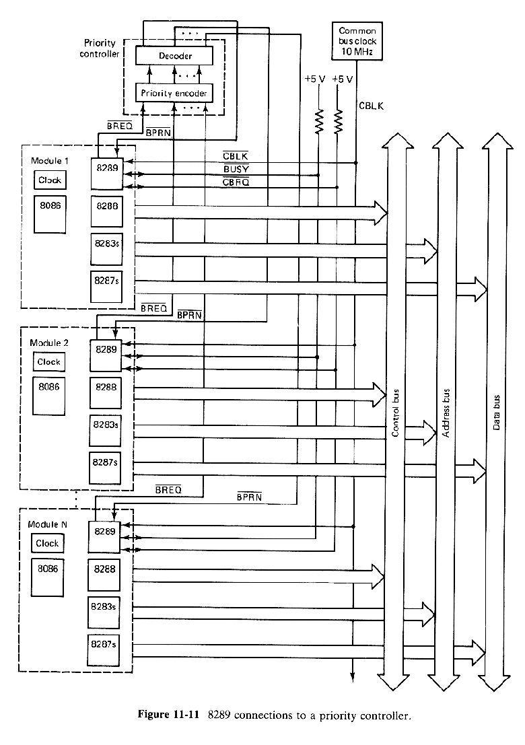
11

Slide 13
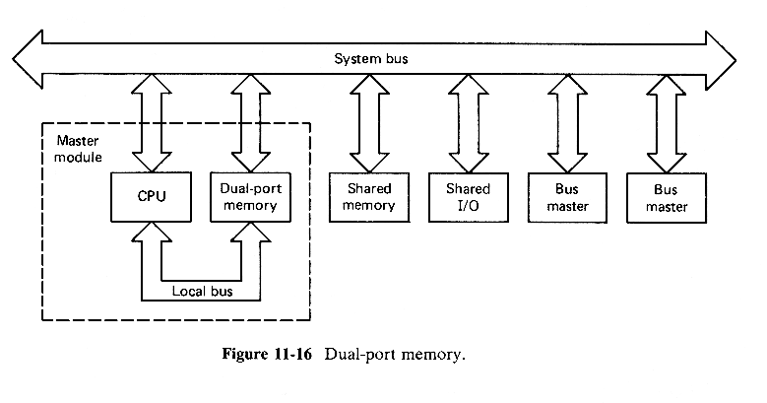
12

Slide 14
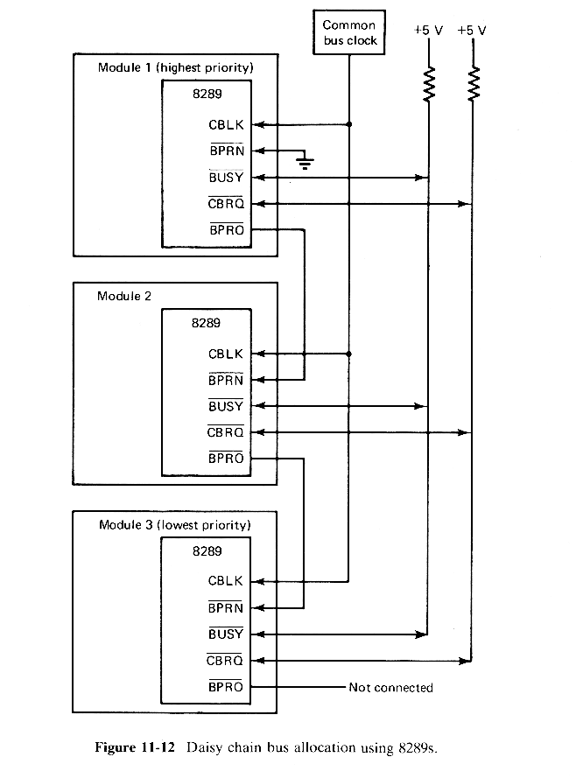
13

Slide 15
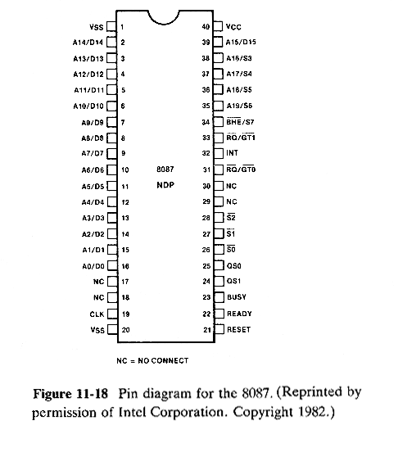
11-3 THE 8087 NUMERIC DATA PROCESSOR
The 8087 numeric data processor (NDP) is specially designed to perform arithmetic operations efficiently.It can operate on data of the integer, decimal, and real types, with lengths ranging from 2 to 10 bytes.The instruction set not only includes various forms of addition, subtraction, multiplication and division, but also provides many useful functions, such as taking the square root, exponentiation, taking the tangent and so on.
As an example of its computing power, the 8087 can multiply two 64-bit real numbers in about 27 µs and calculate a square root in about 36 µs.If performed by the 8086 through emulation, the same operations would require approximately 2 ms and 20 ms, respectively.
14

Slide 16
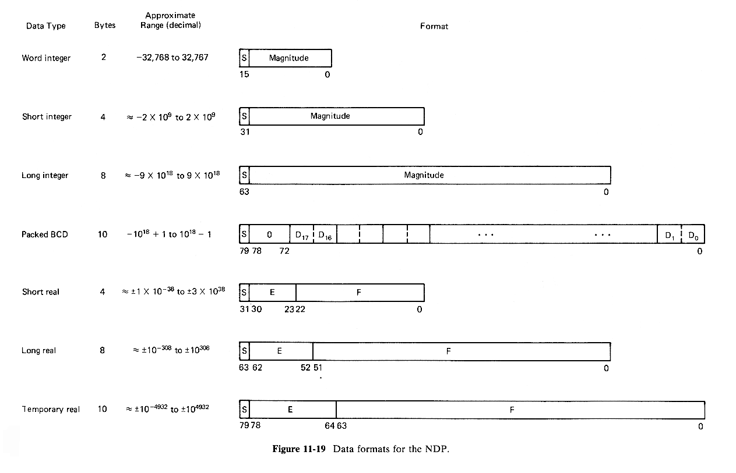
15

Slide 17
The 8086/8088 can operate on integers of only 16 bits, with a range from - 2^15 to 2^15 - 1.In addition to the word integer format, the 8087 allows integer operands to be represented using 32 bits (short integer) and 64 bits (long integer).Negative integers are coded in 2's complement form.The greater number of bits significantly extends the ranges of integers to - 2^31 through 2^31 - 1 for the short integer format and - 2^63 through 2^63 - 1 for the long integer format.This is roughly ± 2 x 10^9 and ± 9 x 10^18, respectively.
In the packed BCD format, a decimal number is stored in 10 bytes.The entire most significant byte is dedicated to the sign.The most significant bit of this byte indicates whether a decimal number is positive (0) or negative (1). The remaining 9 bytes represent the magnitude with two BCD digits packed into each byte.Therefore, the valid range of values in the packed BCD format is - 10^18 + 1 to 10^18 - 1.
The real data types, also called the floating point types, can represent operands which may vary from extremely small to extremely large values and retain a constant number of significant digits during calculations.A real data format is divided into three fields: sign, exponent and mantissa, i.e.,
X = ± 2^exp x mantissa
The exponent adjusts the position of the binary point in the mantissa. Decreasing the exponent by 1 moves the binary point to the right by one position.Therefore, a very small value can be represented by using a negative exponent without losing any precision.However, except for numbers whose mantissa parts fall within the range of the format, a number may not be exactly representable, thus causing a roundoff error.If leading 0s are allowed, a given number may have more than one representation in a real number format.But since there are a fixed number of bits in the mantissa, leading 0s increase the roundoff error.Therefore, in order to minimize the roundoff errors, after each calculation the 8087 deletes the leading 0s by properly adjusting the exponent.A nonzero real number is said to be normalized when its mantissa is in the form of 1.F, where F represents a fraction.
Normally, a bias value is added to the true exponent so that the true exponent is actually the number in the exponent field minus the bias value.Using biased exponents allows two normalized real numbers of the same sign to be compared by simply comparing the bytes from left to right as if they were integers.
16

Slide 18


The 8087 recognizes three real data types: short real, long real and temporary real.In the short real data format, the biased exponent E and the fraction F have 8 and 23 bits, respectively and the number is represented by the form:
(- 1)^S x 2^(E-127) x 1.F
where S is the sign bit.Because the 1 appearing before the fraction is always present, it is implied and is not physically stored.For example, suppose that a short real number is stored as follows:
Then the true exponent is 130 - 127 = 3 and the floating point number being represented is
+1.011011 x 2³ = 1 x 2³ + 1 x 2¹ + 1 x 2° + 1 x 2­² + 1 x 2­³ = 11.375
To illustrate the conversion of a real number to its short real form, consider the number 20.59375.First, one should convert the integral and fractional parts to binary as follows:
10100 + .10011 = 10100.10011
After normalizing this number by moving the binary point until it is between the first and second bits, it is written:
1.010010011 x 2^4
From this form it is seen that
S = 0, E = 127 + 4 = 131 = 10000011 and F = 010010011
and the short real format of the number is:
For the short real data type, the valid range of the biased exponent is 0 < E < 255.Consequently, the numbers that can be represented are from ±2^-126 to ±2^128, approximately ±1 x 10^-38 to ±3 x 10^38.
17

Slide 19
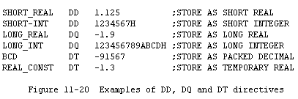
A biased exponent of all 1s is reserved to represent infinity or "not-a-number" (NAN).At the other extreme, a biased exponent of all 0s is used to represent +0 (all 0s with + sign), or a denormal.A denormal is a result that causes an underflow and has leading 0s in the mantissa even after the exponent is adjusted to its smallest possible value.NANs and denormals are normally used to indicate overflows and underflows, respectively, although they may be used for other purposes.
The long real format has 11 exponent bits and 52 fraction bits.As with the short real format, the first nonzero bit in the mantissa is implied and not stored.The range of representable nonzero quantities is extended to approximately ±10^-308 to ±10^308.As a comparison the range of nonzero real numbers for the IBM 370 real format is ±10^-78 to ±10^76.
The 8087 internally stores all numbers in the temporary real format which uses 15 bits for the exponent and 64 bits for the mantissa.Unlike the short and long real formats, the most significant bit in the mantissa is actually stored.Because of the extended precision (19 to 20 decimal digits), integer and packed BCD operands can be operated on internally using floating point arithmetic and still yield exact results.A primary reason for using the temporary real format for internal data storage is to reduce the chance for overflow and underflows during a series of calculations which produce a final result that is within the required range. For example, consider the calculation:
D <- (A*B)/C
where A, B, C and D are in the short real format. The multiply operation may yield a result which is too large to be represented in the short real format, but yet the final result, after the division by C, may still be within the valid range. The 15-bit exponent of the temporary real format extends the range of valid numbers; therefore for most applications the user need not worry about overflow and underflows in the intermediate calculations.
In order to support the 8087's data formats in addition to the DB, DW and DD directives, the ASM-86 assembler provides the data declarations directives DQ (define quadword) and DT (define tenbyte) to allocate storage or define data. The directive DQ is used to define an 8-byte storage block for long integer and long real values in the packed decimal or temporary real format. Some examples are given in Fig.11-20. The PTR operator may be used with the DQ or DT type just as they are with DB, DW and DD types.
18

Slide 20
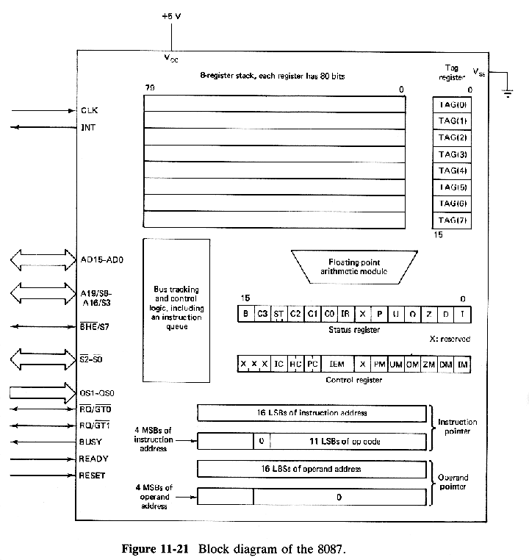
11-3-2 Processor Architecture
A general block diagram of the 8087 is given in Fig.11-21. The monitor and control logic maintains a 6-byte instruction queue (only 4 bytes are used if operand in conjunction with the 8088) and tracks the instruction execution sequence of the host. If the instruction currently being executed by the host is an ESC instruction, the 8087 decodes the external op code to perform the specified operation and also captures the operand and operand address. Instructions other than ESC instructions are simply ignored by the 8087.
There are eight data registers which can be accessed either as a stack or randomly relative to the top of the stack. An operand may be popped from this stack or pushed onto it. The top stack element is pointed to by the ST bits, which are bits 13, 12 and 11 of the status register. A push operation first decrements ST by 1 and then loads the operand into the new top of the stack element and a pop operation retrieves the top of the stack and then increments ST by 1.
As a conventional register file, each register may be referenced by using an index to the stack pointer. This is called relative stack addressing. For relative stack addressing the registers are considered to be in a circle with register 7 being next to register 0. For instance, if ST contains a 3, then ST(2) and ST(6) represent register 5 and register 1 respectively. Because all numbers are internally stored in the temporary real format, each register consists of 80 bits.
18

Slide 21
The status register is 16 bits wide. It reports various errors, stores the condition code for certain instructions, specifies which register is the top of the stack and indicates the busy status. The bit definitions are given below. A 1 in bit 0 through 5, 7 or 15 indicates that the given condition exists.
  Bit 0- I, an invalid operation such as stack overflow, stack underflow, invalid operand, square root of a negative number, etc.
  Bit 1- D, the operand is not normalized.
  Bit 2- Z, a divide-by-zero error.
  Bit 3- O, an exponent overflow error, i.e. the biased exponent is too large.
  Bit 4- U, an exponent underflow, i.e. the biased exponent is too small.
  Bit 5- P, a precision error, i.e. the result is not exactly representable in the destination format and roundoff has been performed. This indication is normally used only for applications where exact results are required.
  Bit 6- Reserved.
  Bit 7- IR, an interrupt request is being made.
  Bits 8, 9, 10 and 14- C0, C1, C2 and C3 indicate the condition code. The condition code is set by the compare and examine instructions, which are discussed later.
  Bits 13, 12 and 11- ST, indicates which element is the top of the stack.
  Bit15- B, the current operation is not complete.
After the 8087 is reset or initialized, all status bits except the condition code are cleared.
Although the 8087 recognizes six error types, each error type may be individually masked from causing an interrupt by setting the corresponding mask bits to 1 in the control register. These mask bits are denoted IM (invalid operation), DM (denormalized operand), ZM (divide-by-zero), OM (overflow), UM (underflow) and PM (Precision error). If masked, the error will not cause an interrupt but, instead, the 8087 will perform a standard response and then proceed with the next instruction in sequence (For description of the standard responses, see Reference 1). In particular, the precision error, for which the standard response is to "return the rounded result" should be masked for floating point arithmetic because for most applications precision errors will occur most of the time. Precision errors are of consequence only in special situations.
Whether an interrupt request, including error-related requests, will be generated also depends on the interrupt enable bit (IEM) in the control register. When this bit is set to 1, all interrupts are disabled except when the CPU is executing a WAIT instruction. If IEM is 0, an unmasked error can cause an interrupt to be sent to the CPU so that the error can be handled by an error-handling-interrupt routine. In the error-handling routine, the current instruction pointer and operand pointer, which are stored in the 8087, can be examined by the 8086/8088 by first putting them into memory. This can be done by using the appropriate 8087 instructions (see Sec.11-3-3). The contents of these pointers identify the instruction and operand address when the error occurred. Note that only the least significant 11 bits of the instruction code are kept in the instruction pointer register because the most significant 5 bits are always 11011, the top code of an ESC instruction.
19

Slide 22
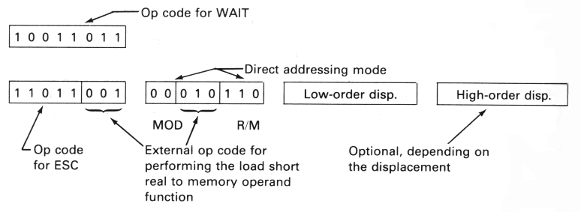
The remaining bits in the control register provide flexibility in controlling precision (PC), rounding (RC) and infinity representations (IC). These bits are defined as follows:
  PC bits
    00 means 24-bit precision.
    01 is reserved.
    10 means 53-bit precision.
    11 means 64-bit precision.
  RC bits
    00 means round to nearest.
    01 means round toward -x.
    10 means round toward +x.
    11 means truncation.
  IC bit
    0 indicates that +x and -x treated as a single unsigned infinitive.
    1 indicates that +x and -x are treated as two signed infinitives.
During a reset or initialization of the 8087, it sets the PC bits to 11, RC bits to 00, IC bit to 0, IEM bit to 0 and all error mask bits to 1.
The tag register holds status of the contents of the data registers. Each data register is associated with two tag bits, which indicate whether its contents are valid (00), zero (01), a special value- i.e. NAN, infinity or decimal- (10) or empty (11).
11-3-3 Instruction Set
The 8087 has 68 instructions, which can be divided into six groups according to their functions. These six groups are referred to as the data transfer, arithmetic, comparison, transcendental, constant, and processor control groups.
Because the 8087 and the host CPU share the same instruction stream, the ASM-86 assembler allows the user to write programs in a super instruction set which consist of the 8086's and the 8087's instructions. For each 8087 instruction, the assembler generates two machine instructions, a wait instruction followed by an ESC instruction whose external code indicates the 8087's instruction. For example, assuming that SHORT_REAL is defined by a DD directive, the instruction
FST SHORT_REAL
which converts the contents of the top of the ST stack to the short real format and stores the result into SHORT_REAL, will be assembled as
20

Slide 23
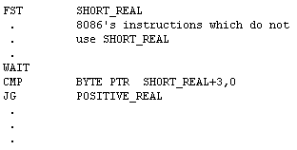
The WAIT instruction preceding the ESC instruction causes the 8086/8088 to enter a wait state until its /TEST pin becomes active and is necessary to prevent the ESC instruction from being decoded before the 8087 completes its current operation. If the /TEST pin is already active or when it becomes active the ESC instruction will be decoded by the 8087 and then both the 8086 and 8087 will proceed in parallel.
However a WAIT must be explicitly included whenever the CPU wants to access a memory operand involved in the previous 8087's instruction. For example in the following sequence the CPU must wait until the 8087 has returned its result to SHORT_REAL before it can execute the CMP instruction:
Note that Intel has a software package that emulates all 8087 instructions. For a program to be executed by emulation the FWAIT instruction, which is an alternate mnemonic for the WAIT instruction, must be used for synchronization. Because there is no 8087 to activate the /TEST pin for emulated execution, the package will change any FWAIT or inserted WAIT to a NOP to avoid an endless wait. However, explicit WAIT instructions are not eliminated from the user's object code.
Let us now consider the definitions of the 8087's assembler language instructions. Many of the assembler instructions allow the user to specify operands in more then one way, either explicitly or implicitly. For such instructions slashes will be employed to separate the alternate operand forms. For instance the operand field denoted
//SRC/DST,SRC
means that the instruction may be coded in any one of the following three forms:
  Both the source and destination operands are implicit (this is indicated by having nothing between the first two slashes)
  The source operand is specified and the destination operand is implicit
  Both the source and destination operands are specified by the user.
21

Slide 24
An operand may be a register in the register stack or a memory operand. For a register operand ST represents the top stack element and ST(i) means the ith register below the top stack element (i.e. the register corresponding to ST+i). A memory operand may be addressed by any of the 8086's data addressing modes.
The data type of a memory operand may be word integer, short integer, long integer, packed BCD, short real, long real or temporary real.
The data transfer group includes the nine instructions which are summarized in Fig.11-22. A memory operand whose type is word integer, short integer, long integer, short real, long real, temporary real or packed BCD can be converted to temporary real and then pushed onto the register stack or a register can be pushed to onto the stack. Conversely the contents of the top stack element can be converted from temporary real to the destination's data format and then stored in memory. In addition instructions are available for popping the contents of a register from the stack and exchanging the contents of a register with the top of the stack. The tag register is updated following each data transfer instruction.
The 8087 has a variety of instructions for performing the arithmetic operations: addition, substraction, multiplication and division. Results are always stored on the top of the register stack or in a specified register and one of the source operands must be the top of the stack. For real arithmetic instructions the other operand may be located in a specified register or in memory. Special forms are provided to pop the stack after the arithmetic operation is completed. Because data are internally represented in the temporary real format arithmetic involving operands of other types can always be accomplished by first loading the operands into the appropriate registers using the data transfer instructions and then performing the real arithmetic operation. However, arithmetic instructions are provided that will accept memory operands of the short real, long real, temporary real, word integer or short integer type and automatically convert these operands to temporary real before performing their operations.
In addition to the basic arithmetic operations the 8087 provides instructions to calculate the square root, adjust scale values using the power of 2, perform modulo division, round real values to integer values, extract the exponent and fraction, take the absolute value and change the sign. These instructions operate on the top one or two stack elements and the result is left on the top of the stack. Figure 11-23 summarizes the arithmetic instructions.
The comparison instructions compare the top of the register stack with the source operand, which may be in another register or in memory, and set the condition codes accordingly. The top stack element may also be compared to 0, or examined to determine its tag, sign or normalization. Condition code settings can be examined by the 8086 or 8088 by storing the status register of the 8087 in memory using a proper 8087 processor control instruction. There are seven instructions in the compare group and they are defined in Fig.11-24.
22

